Slide 1
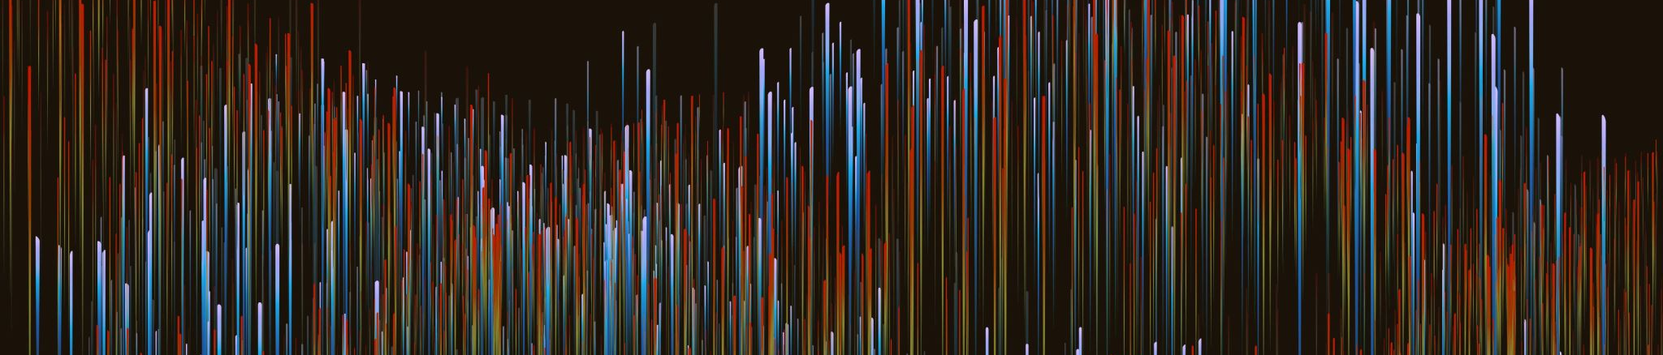
Andrometocs – SpaceSHIP Design Idea
Based on observations and Imaginations; Presenting & Sharing this Idea by Kumaran Kanniappan

Slide 2
Observations From Nature
Galaxies most of them are majorly three shapes
Spiral 2. Elliptical 3. Irregular
Any object in vacuum space, based on density and masses it shrinks to Spherical shape it is approximate one
Combining these two natural facts Galaxy and Planets; The shapes mostly, 1. Sphere and Elliptical or 2. Sphere and Spiral or 3. Sphere and Irregular
Based on the natural observations, my imagination mostly why can’t we build spaceships with similar to over nature that’s going to cover gravitational forces our earth nature as well; So I draw these spaceships in my mind that may be useful in future days;

Slide 3
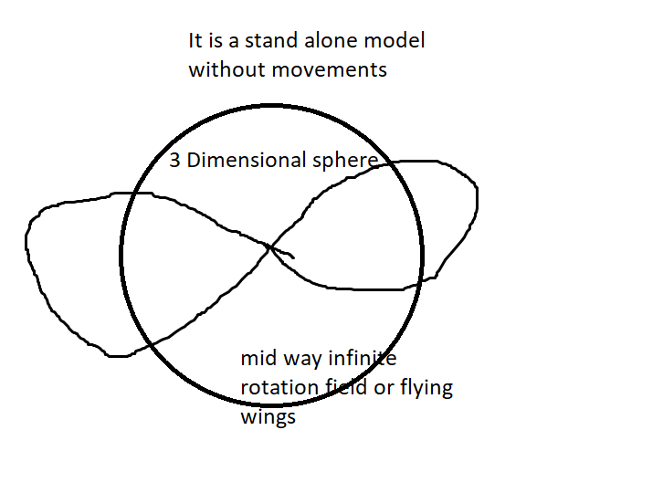
Stand-Alone Type 1 Shapeship

Slide 4
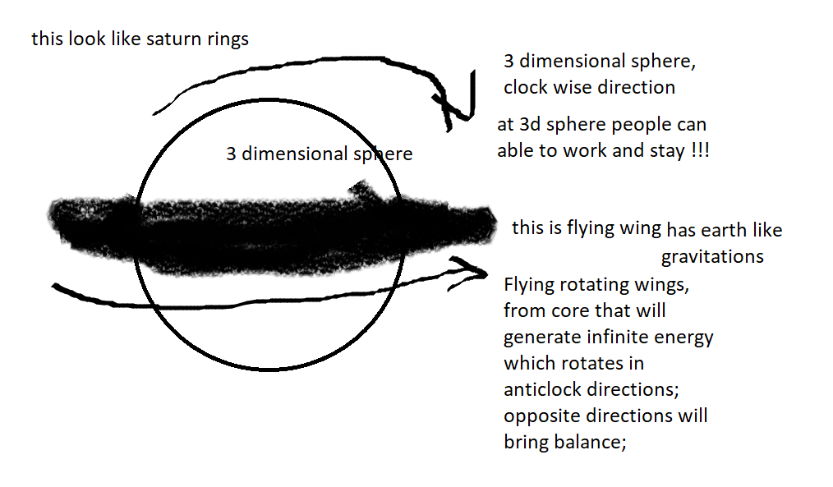
In Movements Type 1 Shapeship will be like this

Slide 5
This idea is from natural observations and imagination of sharing worthful Ideas
When draw that diagram in my mind; I compared with nature, space science objects, stars and galaxies.
May be it will be useful for Space Research and Space Exploration purposes.

